Slide 1
IATEFL Highlights
Liverpool 2013

Slide 2
WARMER

Slide 3
warmer
Trends, issues and new developments
Which ones came up repeatedly?
  .
  .
  .
  .
  .
  .
  .
  .

Slide 4
warmer
Trends, issues and new developments
These ones came up repeatedly in the past:
  Task-based Learning
  The Lexical Approach
  Corpus Linguistics
  CALL
  Blended Learning
  ELF
  CLIL
  Dogme

Slide 5
warmer
Trends, issues and new developments
Which ones came up repeatedly?
  .
  .
  .
  .
  .
  .
  .
  .

Slide 6
warmer
Trends, issues and new developments
Which ones came up repeatedly?
  Ways of teaching grammar
  .
  .
  .
  .
  .
  .
  .

Slide 7
warmer
Trends, issues and new developments
Which ones came up repeatedly?
  Ways of teaching grammar on your phone or tablet
  .
  .
  .
  .
  .
  .
  .

Slide 8
warmer
Trends, issues and new developments
Which ones came up repeatedly?
  Ways of teaching grammar on your phone or tablet
  Using learning technology
  .
  .
  .
  .
  .
  .

Slide 9
warmer
Trends, issues and new developments
Which ones came up repeatedly?
  Ways of teaching grammar on your phone or tablet
  Using learning technology on your phone or tablet
  .
  .
  .
  .
  .
  .

Slide 10
warmer
Trends, issues and new developments
Which ones came up repeatedly?
  Ways of teaching grammar on your phone or tablet
  Using learning technology on your phone or tablet
  English for Academic Purposes
  .
  .
  .
  .
  ..

Slide 11
warmer
Trends, issues and new developments
Which ones came up repeatedly?
  Ways of teaching grammar on your phone or tablet
  Using learning technology on your phone or tablet
  English for Academic Purposes on your phone or tablet
  .
  .
  .
  .
  .

Slide 12
warmer
Trends, issues and new developments
Which ones came up repeatedly?
  Ways of teaching grammar on your phone or tablet
  Using learning technology on your phone or tablet
  English for Academic Purposes on your phone or tablet
  Motivating learners .
  .
  .
  .
  .

Slide 13
warmer
Trends, issues and new developments
Which ones came up repeatedly?
  Ways of teaching grammar on your phone or tablet
  Using learning technology on your phone or tablet
  English for Academic Purposes on your phone or tablet
  Motivating learners on your phone or tablet
  .
  .
  .
  .

Slide 14
warmer
Trends, issues and new developments
Which ones came up repeatedly?
  Ways of teaching grammar on your phone or tablet
  Using learning technology on your phone or tablet
  English for Academic Purposes on your phone or tablet
  Motivating learners on your phone or tablet
  The future of coursebooks
  .
  .
  .

Slide 15
warmer
Trends, issues and new developments
Which ones came up repeatedly?
  Ways of teaching grammar on your phone or tablet
  Using learning technology on your phone or tablet
  English for Academic Purposes on your phone or tablet
  Motivating learners on your phone or tablet
  The future of coursebooks on your phone or tablet
  .
  .
  .

Slide 16
warmer
Trends, issues and new developments
Which ones came up repeatedly?
  Ways of teaching grammar on your phone or tablet
  Using learning technology on your phone or tablet
  English for Academic Purposes on your phone or tablet
  Motivating learners on your phone or tablet
  The future of coursebooks on your phone or tablet
  Dogme lessons
  .
  .

Slide 17
warmer
Trends, issues and new developments
Which ones came up repeatedly?
  Ways of teaching grammar on your phone or tablet
  Using learning technology on your phone or tablet
  English for Academic Purposes on your phone or tablet
  Motivating learners on your phone or tablet
  The future of coursebooks on your phone or tablet
  Dogme lessons on your phone or tablet
  .
  .

Slide 18
warmer
Trends, issues and new developments
Which ones came up repeatedly?
  Ways of teaching grammar on your phone or tablet
  Using learning technology on your phone or tablet
  English for Academic Purposes on your phone or tablet
  Motivating learners on your phone or tablet
  The future of coursebooks on your phone or tablet
  Dogme lessons on your phone or tablet
  The flipped classroom
  .

Slide 19
warmer
Trends, issues and new developments
Which ones came up repeatedly?
  Ways of teaching grammar on your phone or tablet
  Using learning technology on your phone or tablet
  English for Academic Purposes on your phone or tablet
  Motivating learners on your phone or tablet
  The future of coursebooks on your phone or tablet
  Dogme lessons on your phone or tablet
  The flipped classroom on your phone or tablet
  .

Slide 20
warmer
Trends, issues and new developments
Which ones came up repeatedly?
  Ways of teaching grammar on your phone or tablet
  Using learning technology on your phone or tablet
  English for Academic Purposes on your phone or tablet
  Motivating learners on your phone or tablet
  The future of coursebooks on your phone or tablet
  Dogme lessons on your phone or tablet
  The flipped classroom on your phone or tablet
  Mobile learning

Slide 21
warmer
Trends, issues and new developments
Which ones came up repeatedly?
  Ways of teaching grammar on your phone or tablet
  Using learning technology on your phone or tablet
  English for Academic Purposes on your phone or tablet
  Motivating learners on your phone or tablet
  The future of coursebooks on your phone or tablet
  Dogme lessons on your phone or tablet
  The flipped classroom on your phone or tablet
  Mobile learning on your phone or tablet

Slide 22
Opening Plenary david crystal

Slide 23
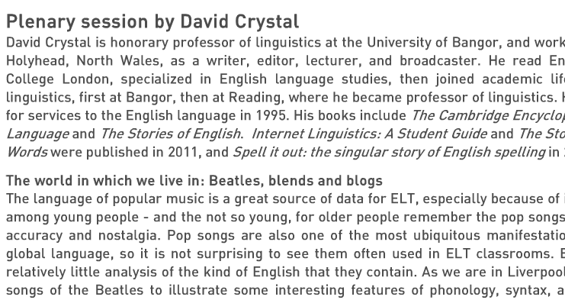
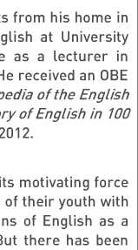
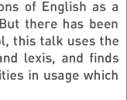
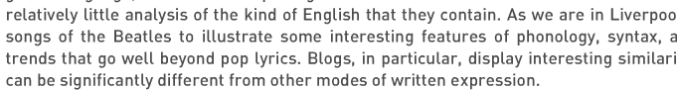
Opening plenary: david crystal

Slide 24
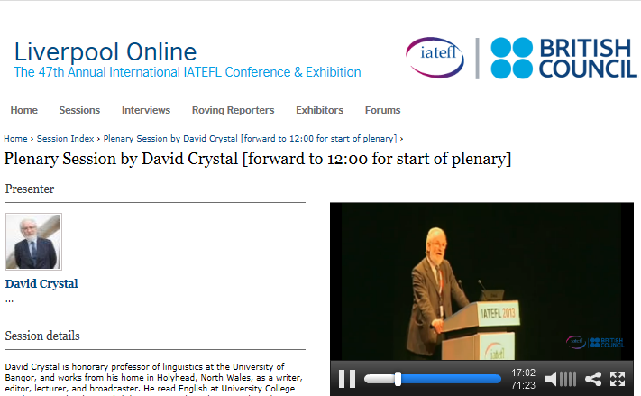
Opening plenary: david crystal

Slide 25
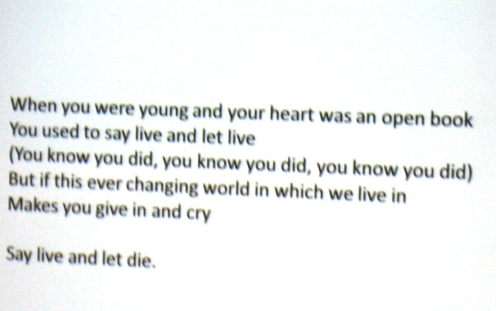
Opening plenary: david crystal

Slide 26
Opening plenary: david crystal
Blending:
  Linguistic
    brunch
  Syntactic
    This ever changing world in which we live in

Slide 27
Opening plenary: david crystal
Blending:
  Linguistic
    brunch
  Syntactic
    This ever changing world in which we live in

Slide 28
Opening plenary: david crystal
IATEFL Online: Opening plenary and other sessions
http://iatefl.britishcouncil.org/2013/sessions/index

Slide 29
Does the word “synonym” have a synonym?
Leo Selivan

Slide 30
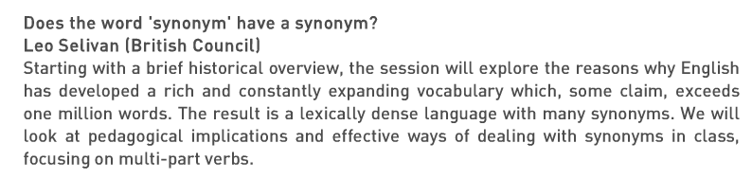
Does the word...?: Leo selivan

Slide 31
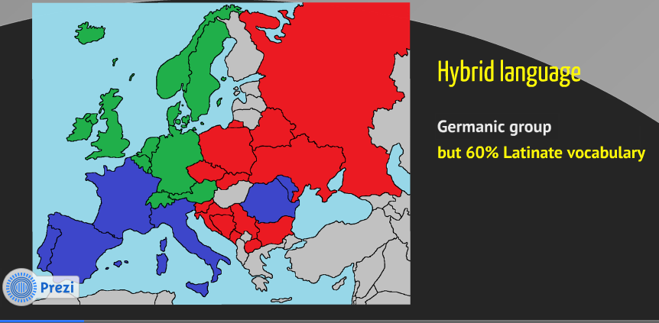
Does the word...?: Leo selivan

Slide 32
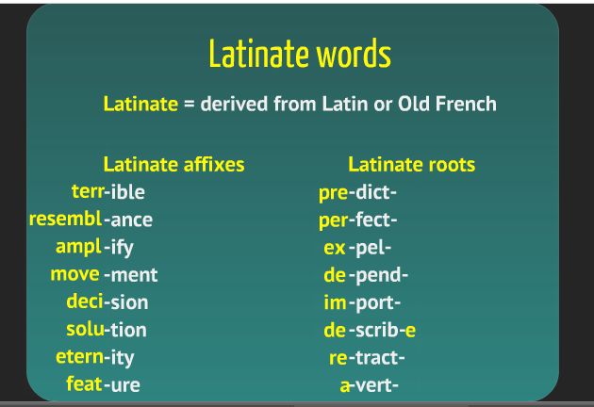
Does the word...?: Leo selivan

Slide 33
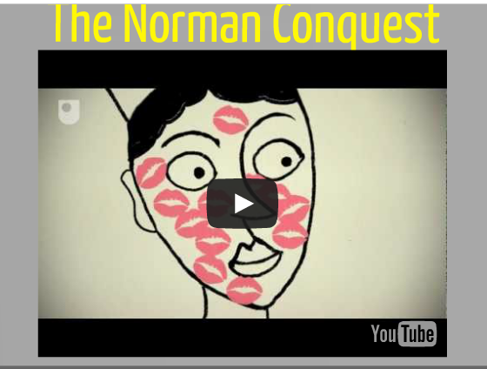
Does the word...?: Leo selivan

Slide 34
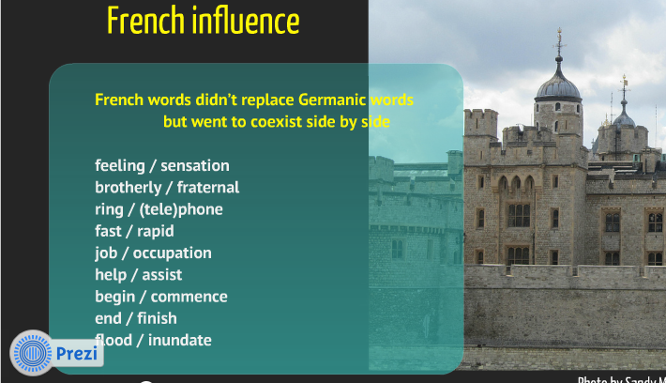
Does the word...?: Leo selivan

Slide 35
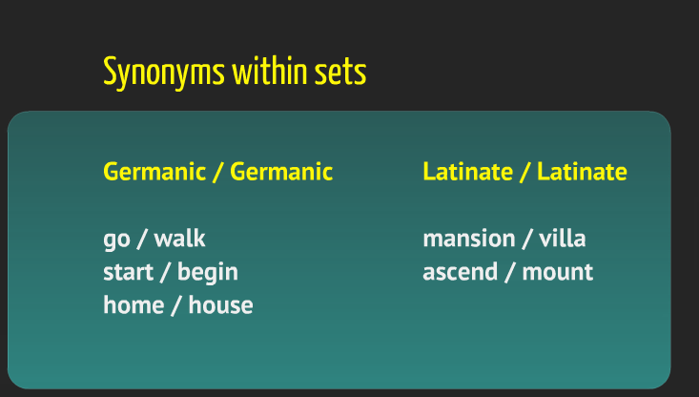
Does the word...?: Leo selivan

Slide 36
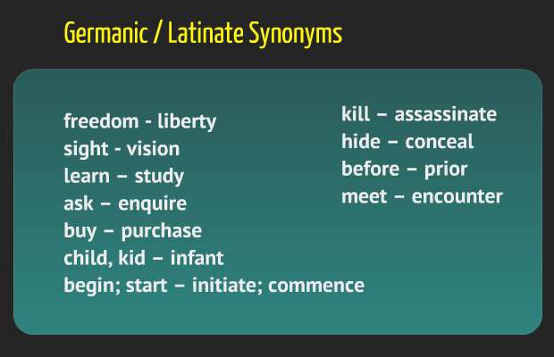
Does the word...?: Leo selivan

Slide 37
Does the word...?: Leo selivan

Slide 38
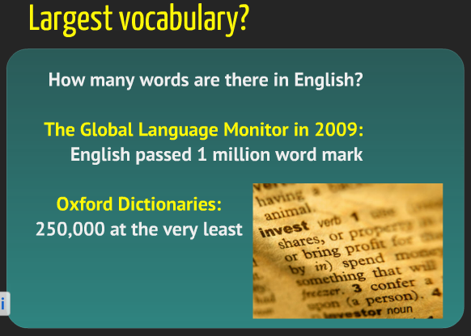
Does the word...?: Leo selivan

Slide 39
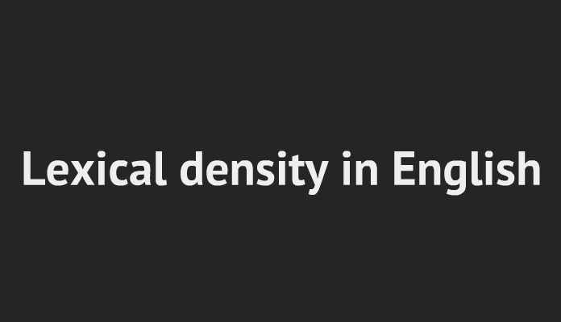
Does the word...?: Leo selivan

Slide 40
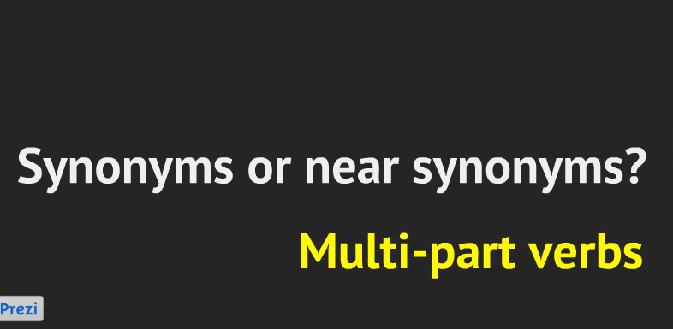
Does the word...?: Leo selivan

Slide 41
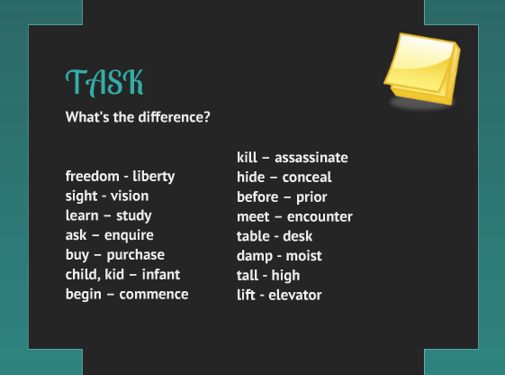
Does the word...?: Leo selivan

Slide 42
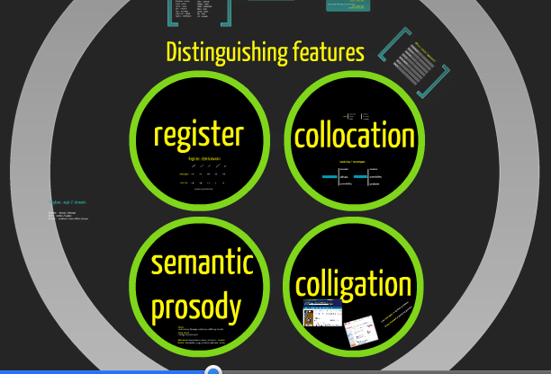
Does the word...?: Leo selivan

Slide 43
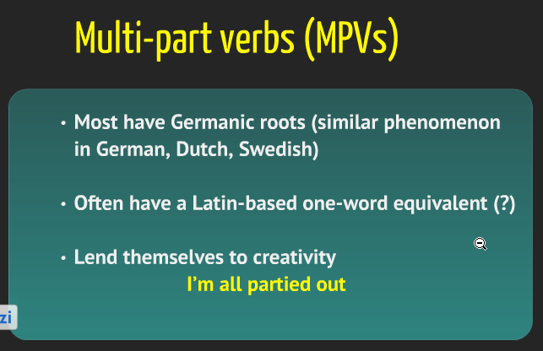
Does the word...?: Leo selivan

Slide 44
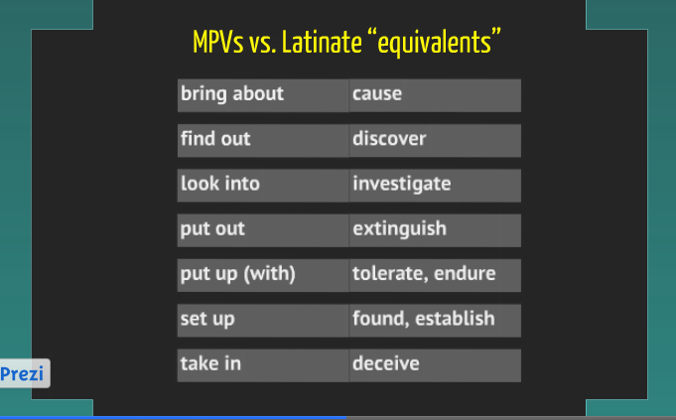
Does the word...?: Leo selivan

Slide 45
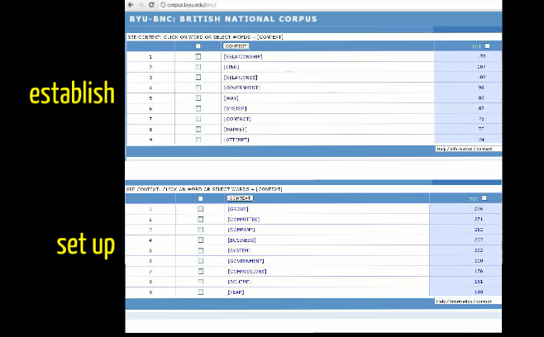
Does the word...?: Leo selivan

Slide 46
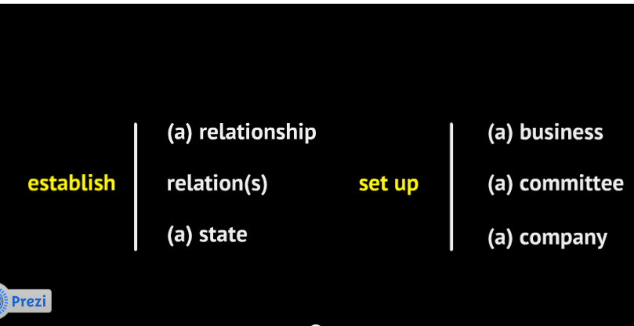
Does the word...?: Leo selivan

Slide 47
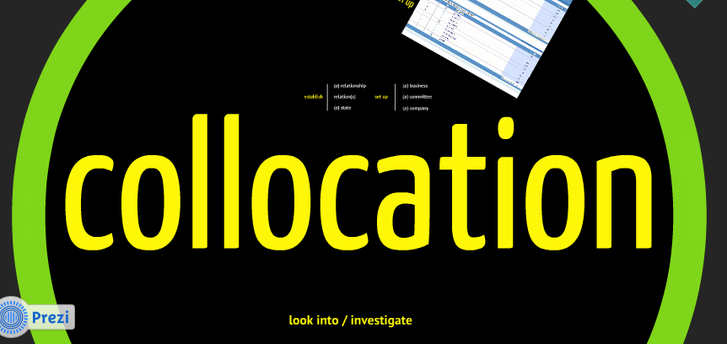
Does the word...?: Leo selivan

Slide 48
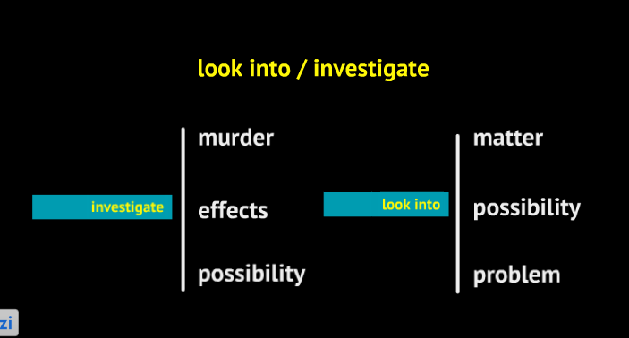
Does the word...?: Leo selivan

Slide 49
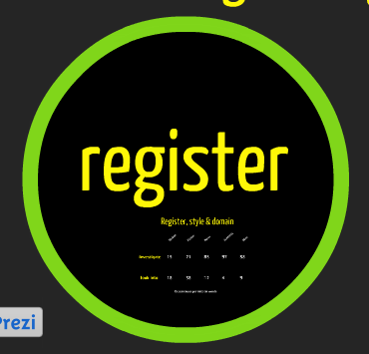
Does the word...?: Leo selivan

Slide 50
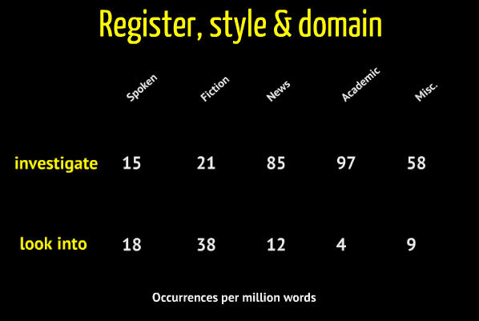
Does the word...?: Leo selivan

Slide 51
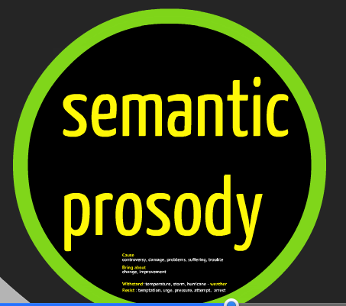
Does the word...?: Leo selivan

Slide 52
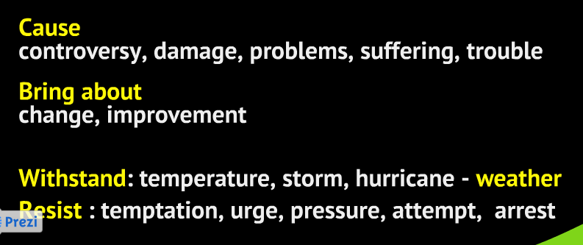
Does the word...?: Leo selivan

Slide 53
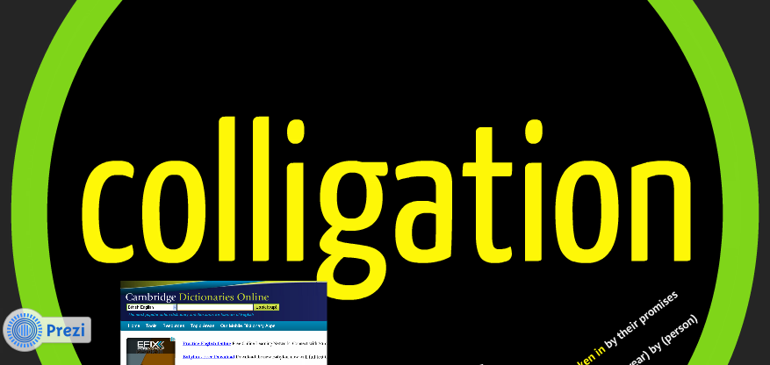
Does the word...?: Leo selivan

Slide 54
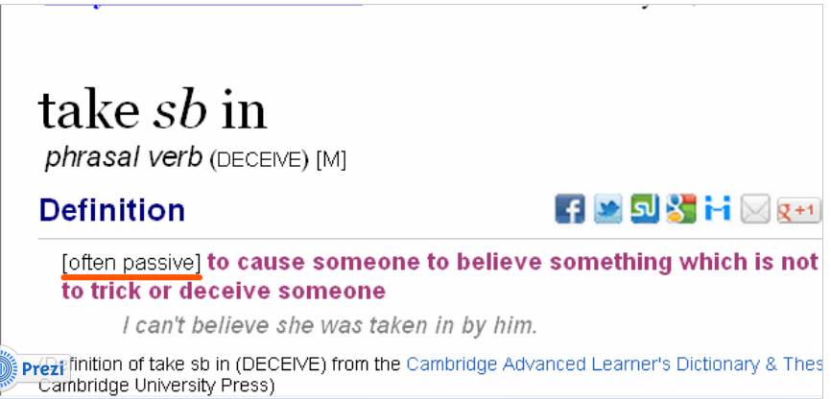
Does the word...?: Leo selivan

Slide 55
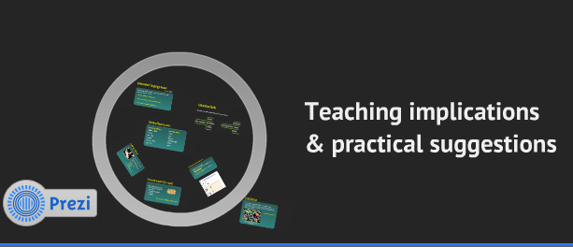
Does the word...?: Leo selivan

Slide 56
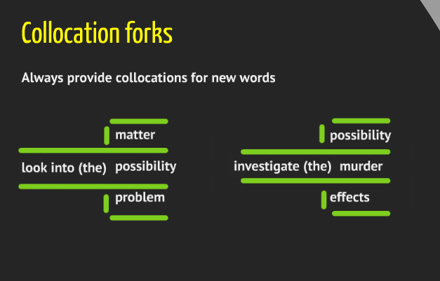
Does the word...?: Leo selivan

Slide 57
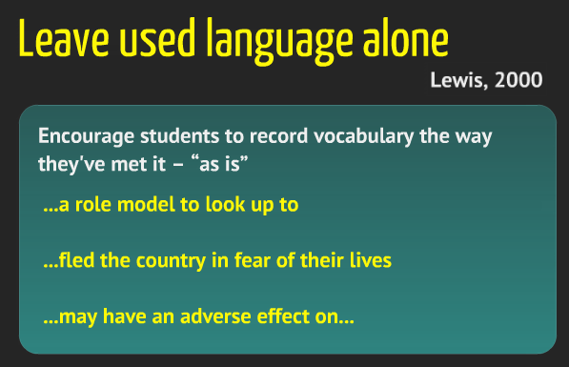
Does the word...?: Leo selivan

Slide 58
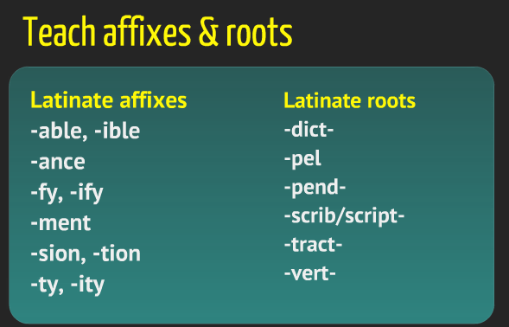
Does the word...?: Leo selivan

Slide 59
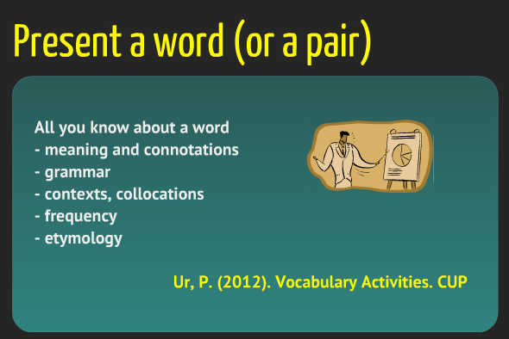
Does the word...?: Leo selivan

Slide 60
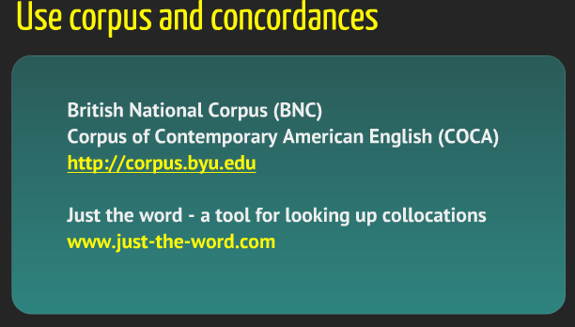
Does the word...?: Leo selivan

Slide 61
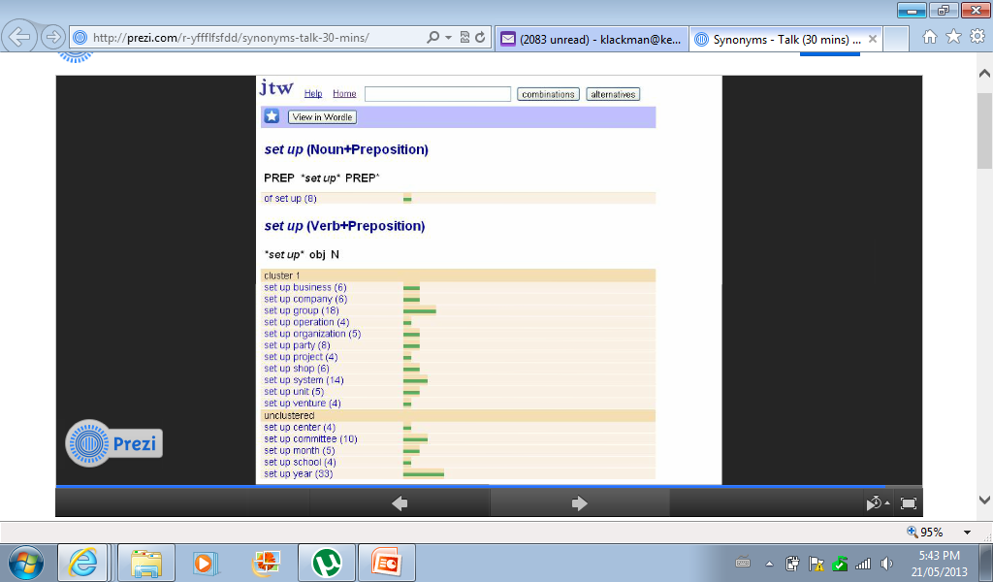
Does the word...?: Leo selivan

Slide 62
Does the word...?: Leo selivan

Slide 63
Does the word...?: Leo selivan

Slide 64
Does the word...?: Leo selivan

Slide 65
Does the word...?: Leo selivan
http://www.just-the-word.com/

Slide 66
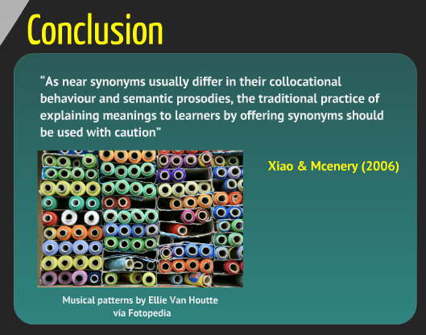
Does the word...?: Leo selivan

Slide 67
Does the word...?: Leo SElivan
Leo’s IATEFL presentation
http://prezi.com/r-yffflfsfdd/synonyms-talk-30-mins/

Slide 68
In our own write
Nick Bilbrough

Slide 69
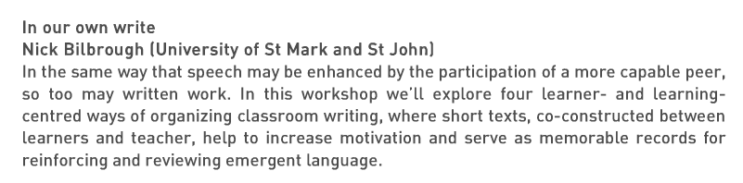
In our own write: Nick bilbrough

Slide 70
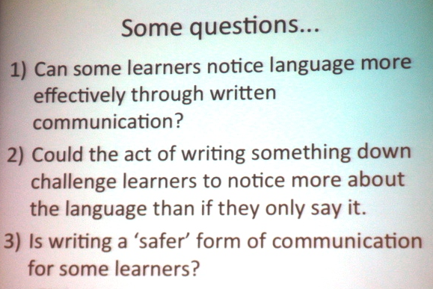
In our own write: Nick bilbrough

Slide 71
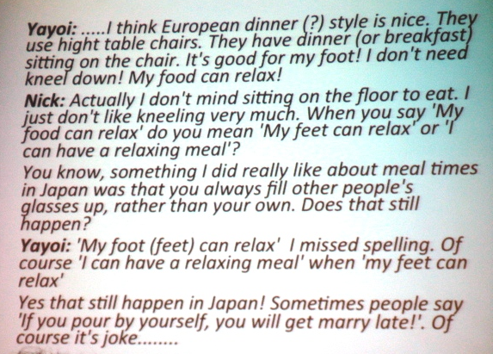
In our own write: Nick bilbrough

Slide 72
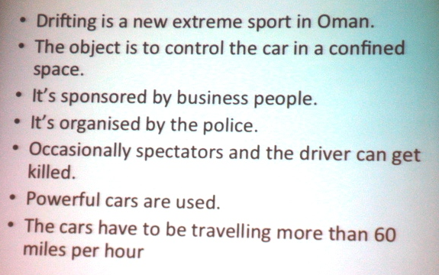
In our own write: Nick bilbrough

Slide 73
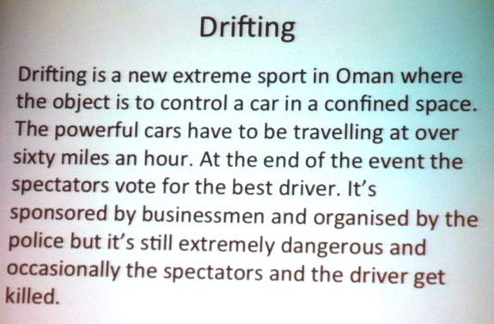
In our own write: Nick bilbrough

Slide 74
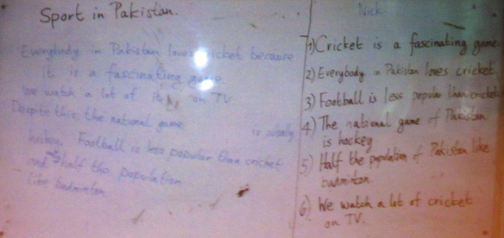
In our own write: Nick bilbrough

Slide 75
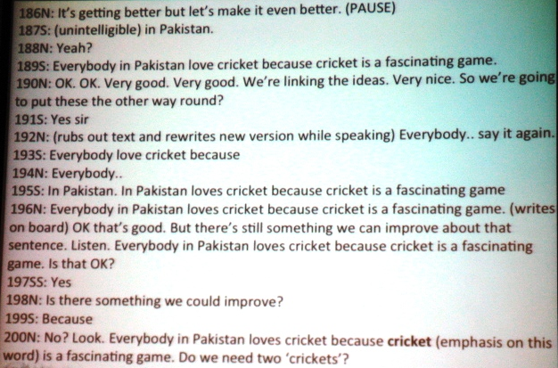
In our own write: Nick bilbrough

Slide 76
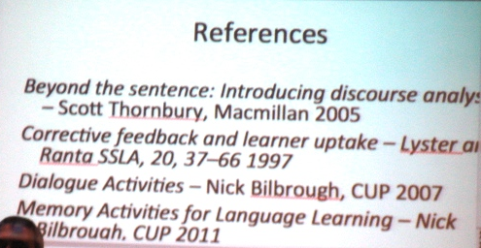
In our own write: Nick bilbrough

Slide 77
PHRASAL VERBS: Do your students give up or get ahead
Celia Wigley & Lisa Sutherland

Slide 78
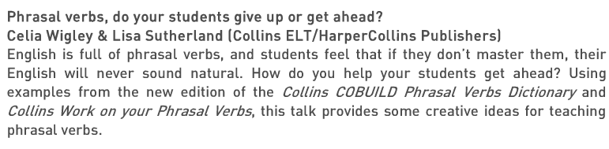
Phrasal Verbs: Lisa & Celia

Slide 79
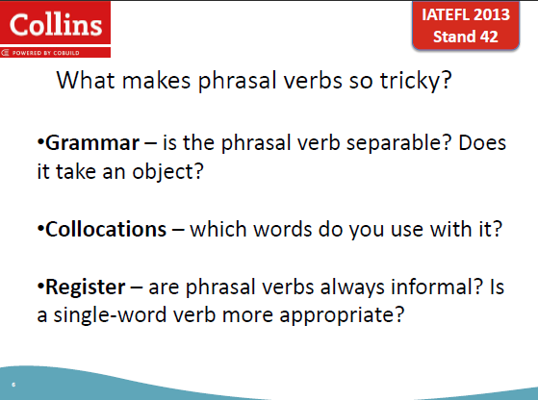
Phrasal Verbs: Lisa & Celia

Slide 80
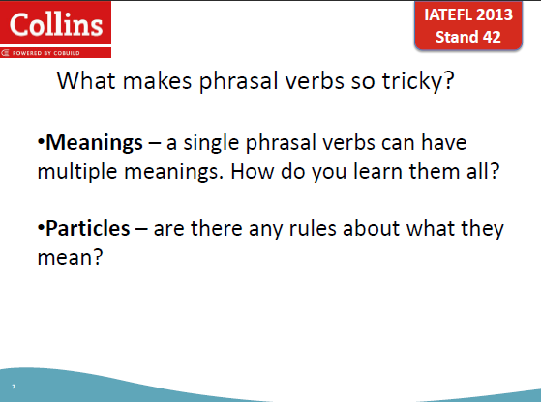
Phrasal Verbs: Lisa & Celia

Slide 81
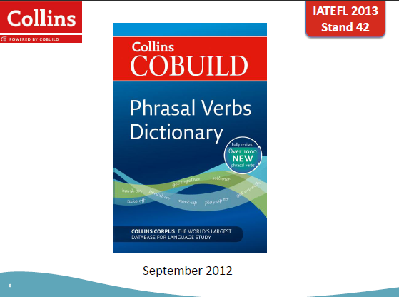
Phrasal Verbs: Lisa & Celia

Slide 82

Phrasal Verbs: Lisa & Celia

Slide 83

Phrasal Verbs: Lisa & Celia

Slide 84

Phrasal Verbs: Lisa & Celia

Slide 85

Phrasal Verbs: Lisa & Celia

Slide 86

Phrasal Verbs: Lisa & Celia

Slide 87

Phrasal Verbs: Lisa & Celia

Slide 88

Phrasal Verbs: Lisa & Celia

Slide 89

Phrasal Verbs: Lisa & Celia

Slide 90

Phrasal Verbs: Lisa & Celia

Slide 91

Phrasal Verbs: Lisa & Celia

Slide 92
Phrasal Verbs: Lisa & Celia
Phrasal verb activity: Particle Beep
Give each pair/group a set of cards with different particles on them (e.g., up, down, on, off, in, out). Students put cards down in front of them. Read a story with no more than one phrasal verb in a sentence. Instead of reading the particle, say “beep”. At the end of the sentence, students hold up the card with the particle they think it is. Confirm the answer and continue the story in the same way.
Sample story:
I had to get beep early yesterday. Just before leaving, I took beep the garbage and then locked the door. Then I headed beep to Union Station. I had to go there to pick someone beep. Once I’d done that, I had to take my car beep for repairs. On the subway ride home, I met an old friend and I took beep his number so I could call him sometime. That was my day yesterday.

Slide 93
Phrasal Verbs: Lisa & Celia
Celia’s favourite phrasal verb activities
http://www.collinslanguage.com/tips-for-teachers-phrasal-verbs-our-top-tips-and-favourite-classroom-activities
Celia and Lisa’s IATEFL presentation
http://harpercollinsnews.co.uk/AEM/Clients/COL002/ELT/IATEFL13CeliaandLisa.pdf

Slide 94
ELTJ Adult coursebooks review 2001 - 2012
Hitomi Masuhara

Slide 95

Coursebook review: Hitomi Masuhara

Slide 96

Coursebook review: Hitomi Masuhara

Slide 97

Coursebook review: Hitomi Masuhara

Slide 98

Coursebook review: Hitomi Masuhara

Slide 99

Coursebook review: Hitomi Masuhara

Slide 100
Coursebook review: Hitomi Masuhara
http://www.matsda.org/

Slide 101
Semantic Priming, Repetition Priming, Lexical Priming and the Unprimed Learner
Michael Hoey

Slide 102

Semantic Priming...: Michael Hoey

Slide 103

Semantic Priming...: Michael Hoey

Slide 104

Semantic Priming...: Michael Hoey

Slide 105

Semantic Priming...: Michael Hoey

Slide 106

Semantic Priming...: Michael Hoey

Slide 107

Semantic Priming...: Michael Hoey

Slide 108

Semantic Priming...: Michael Hoey

Slide 109

Semantic Priming...: Michael Hoey

Slide 110

Semantic Priming...: Michael Hoey

Slide 111

Semantic Priming...: Michael Hoey

Slide 112

Semantic Priming...: Michael Hoey

Slide 113

Semantic Priming...: Michael Hoey

Slide 114

Semantic Priming...: Michael Hoey

Slide 115
Semantic Priming...: Michael Hoey

Slide 116

Semantic Priming...: Michael Hoey

Slide 117

Semantic Priming...: Michael Hoey

Slide 118
Semantic Priming...: Michael Hoey

Slide 119
Grammar rules: Help or hindrance?
Peter Bendall

Slide 120

Grammar rules: Peter Bendall

Slide 121

Grammar rules: Peter Bendall

Slide 122

Grammar rules: Peter Bendall

Slide 123

Grammar rules: Peter Bendall

Slide 124

Grammar rules: Peter Bendall

Slide 125

Grammar rules: Peter Bendall

Slide 126
Using Springpad to create an online coursebook hakan senturk

Slide 127

Using springpad...: hakan senturk

Slide 128

Using springpad...: hakan senturk

Slide 129

Using springpad...: hakan senturk

Slide 130

Using springpad...: hakan senturk

Slide 131

Using springpad...: hakan senturk

Slide 132
Using springpad...: hakan senturk

Slide 133

Using springpad...: hakan senturk
http://springpad.com/about

Slide 134
How to write a good task felicity o’Dell

Slide 135

How to write a...: Felicity o’dell

Slide 136

How to write a...: Felicity o’dell

Slide 137

How to write a...: Felicity o’dell

Slide 138
How to write a...: Felicity o’dell

Slide 139
How to write a...: Felicity o’dell

Slide 140
How to write a...: Felicity o’dell

Slide 141
How to write a...: Felicity o’dell

Slide 142
How to write a...: Felicity o’dell

Slide 143
How to write a...: Felicity o’dell

Slide 144
How to write a...: Felicity o’dell

Slide 145
How to write a...: Felicity o’dell

Slide 146
How to write a...: Felicity o’dell

Slide 147
How to write a...: Felicity o’dell

Slide 148
How to write a...: Felicity o’dell

Slide 149
How to write a...: Felicity o’dell

Slide 150

How to write a...: Felicity o’dell

Slide 151
How to write a...: Felicity o’dell

Slide 152
How to write a...: Felicity o’dell

Slide 153
How to write a...: Felicity o’dell

Slide 154

How to write a...: Felicity o’dell

Slide 155
Patterns not rules: Why we need a radically different paradigm rita baker

Slide 156

Patterns, not rules: Rita Baker

Slide 157

Patterns, not rules: Rita Baker

Slide 158
Patterns, not rules: Rita Baker

Slide 159
Patterns, not rules: Rita Baker

Slide 160
Patterns, not rules: Rita Baker

Slide 161
Patterns, not rules: Rita Baker

Slide 162
Patterns, not rules: Rita Baker

Slide 163
Patterns, not rules: Rita Baker

Slide 164
Patterns, not rules: Rita Baker

Slide 165

Patterns, not rules: Rita Baker

Slide 166

Patterns, not rules: Rita Baker

Slide 167

Patterns, not rules: Rita Baker

Slide 168

Patterns, not rules: Rita Baker

Slide 169

Patterns, not rules: Rita Baker

Slide 170

Patterns, not rules: Rita Baker

Slide 171

Patterns, not rules: Rita Baker

Slide 172

Patterns, not rules: Rita Baker

Slide 173
Upcoming
Workshops

Slide 174
Upcoming workshop
  Grammar Made Simple
An overview of English grammar that:
  explains the “tense” system
  points out the difference between time, tense and aspect
  provides simple explanations of verb “tenses” for students
  explains the system behind conditionals
  will simplify the teaching of modals
  will make grammar easier to understand and teach
English Central Wednesday, June 12
60 St. Clair E. 5:30 – 7:00

Slide 175
Upcoming workshop
  You: The Wired ESL Teacher
Find the best ESL web resources, including:
  sanity savers for lesson preparation
  googols of grammar resources
  inspired writing resources
  lively listening resources
  perfect pronunciation resources
  better Business English resources
English Central Wednesday, June 5
60 St. Clair E. 5:30 – 7:00

